Slide 1
Enabling Progressive System Integration for AIoT and Speech-based HCI through Semantic-aware Computing
The Journal of Supercomputing, July 2021
國立臺中科技大學 資訊工程系
張家瑋 助理教授

Slide 2
INTROUDCTION - Smart Home
Artificial intelligence (AI) has empowered IoT technology in people’s home lives and will bring about significant changes to human lifestyles.
Smart homes are the most likely and most important landing scenario for artificial intelligence on the home consumer side, and the smart speaker is the best implementation of the smart home at this stage.
The smart home is intended to make users’ lives safer and more convenient and efficient, and even reduce expenses and increase the entertainment value.

Slide 3
INTROUDCTION - Smart Speaker
In smart homes, the IoT hub centrally controls all hardware devices. Furthermore, humans can control hardware devices through a virtual assistant as an interface.
The “voice assistant” applied in smart speakers can help users play music, query information, control home appliances (e.g., air-conditioning, lighting, and security alerts), and have access to weather, traffic, and other real-time information.
Smart speakers apply three elements, i.e., hardware, content, and service, to allow users to obtain more value-added services.

Slide 4
INTROUDCTION - Natural Language Processing
The smart speaker system itself includes three major NLP technologies:
automatic speech recognition (ASR)
natural language generation (NLG)
text to speech (TTS)

Slide 5
INTROUDCTION – Difficulties in Smart Home
In Chinese, a single word may not be the smallest unit for a semantic analysis, and thus the most significant difference compared to English is the ability of word segmentation in Chinese, which also increases the difficulty of processing.
The current IoT ecosystem is extremely dependent on the brand platform, often resulting in an eco-exclusive situation in which IoT vendors have their own platforms. In most cases, integration with other platforms is poor and unfriendly.
In a human–computer interaction, the smartest speakers require precise commands, resulting in a relatively rigid and unintelligent input and output, which is unsuitable for a user experience.

Slide 6
INTROUDCTION – Objectives
Develop a semantic-aware chatbot framework that can handle Chinese, allowing the user’s conversations to be analyzed, their intentions to be understood, and the corresponding action to be performed without explicit instructions.
Implement a smart speaker with a training chatbot framework and allow users to interact through voice commands.
Deploy the proposed chatbot framework on an existing chatbot channel, such as LINE, thereby allowing users to interact through text commands.
Integrate IoT appliances and sensing devices, including local and third-party IoT devices, in the proposed framework.
Integrate customized local or cloud services within the proposed framework, e.g., access the control system, check the weather, or schedule a calendar event.
Extend different chat topic modules according to user needs.

Slide 7
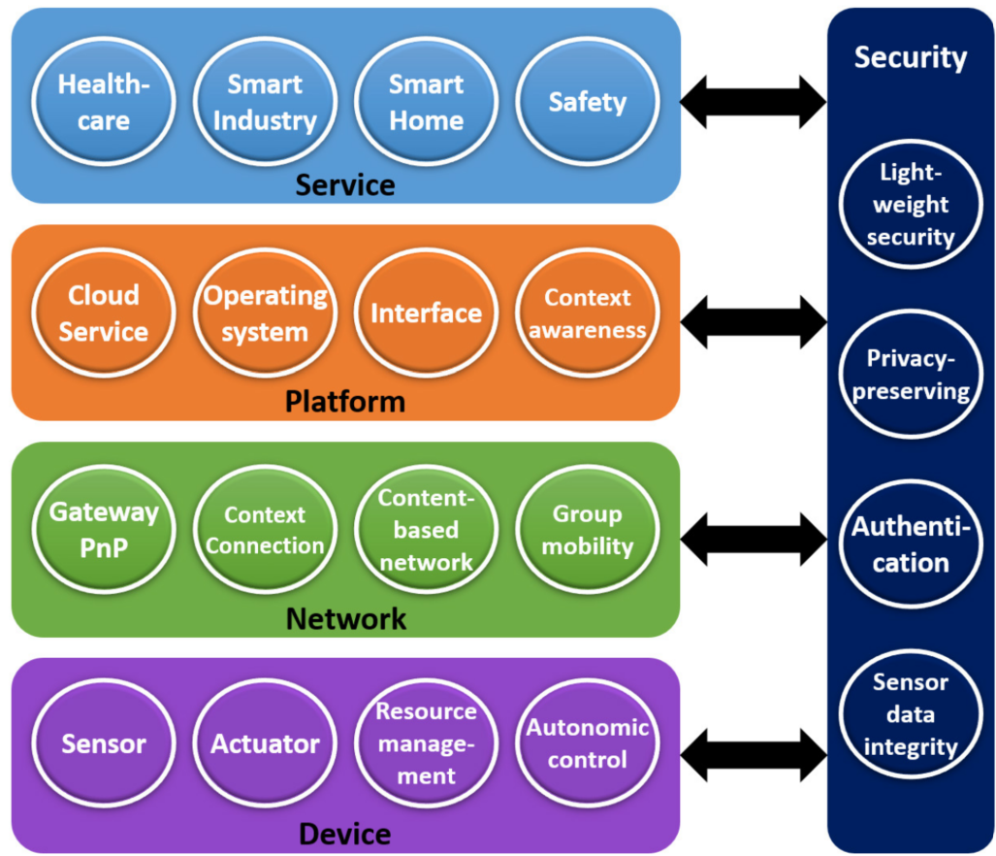
Related Works – Internet of Things
The service layer provides interfaces for communication with users.
The platform layer supports IoT applications and services.
The network layer should be able to process, control, and manage enormous amounts of network trafﬁc.
The device layer is used to perceive the environment with various sensing devices.

Slide 8
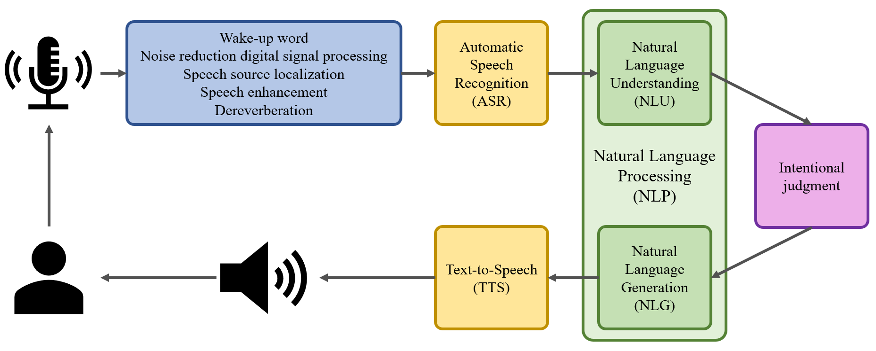
Related Works – Workflow of Smart Speaker

Slide 9
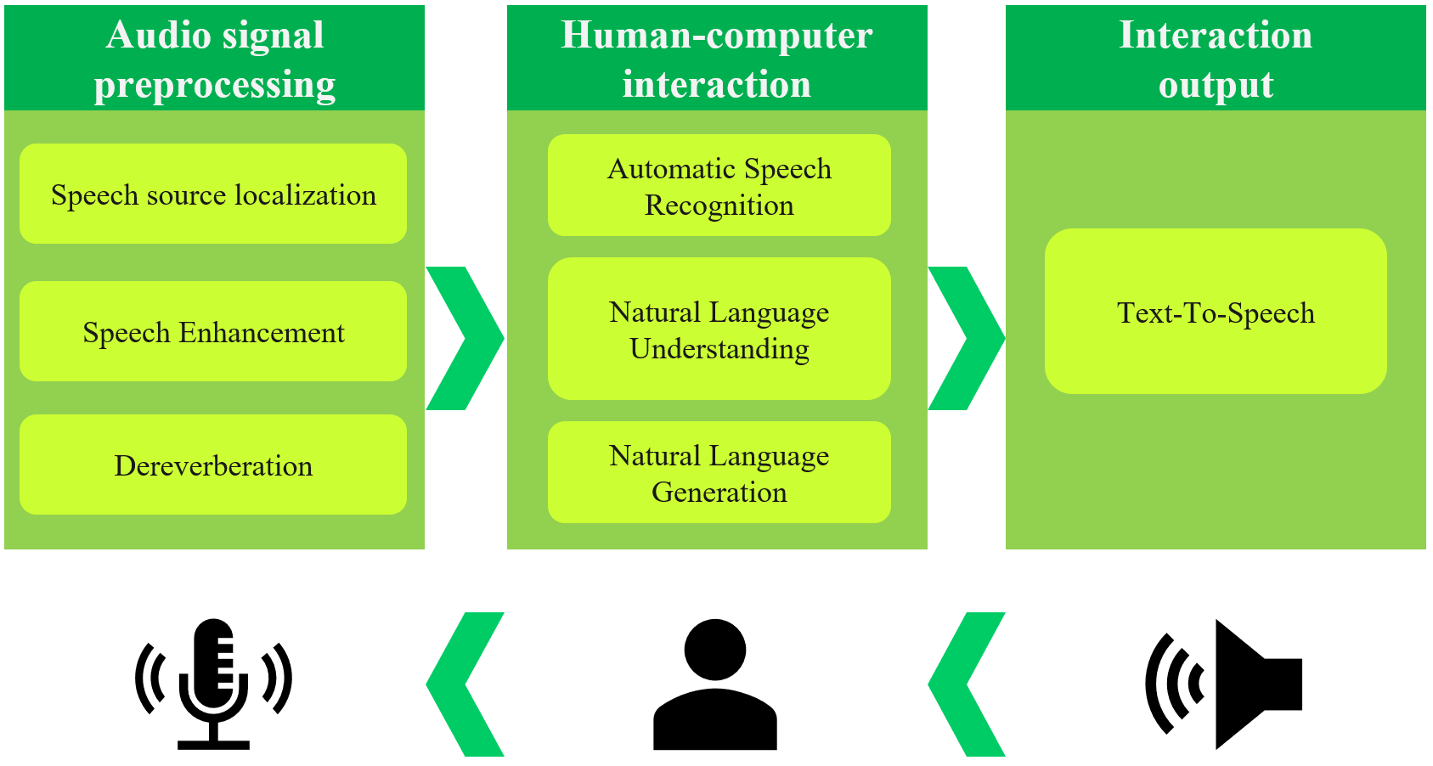
Software Workflow of Smart Speaker

Slide 10
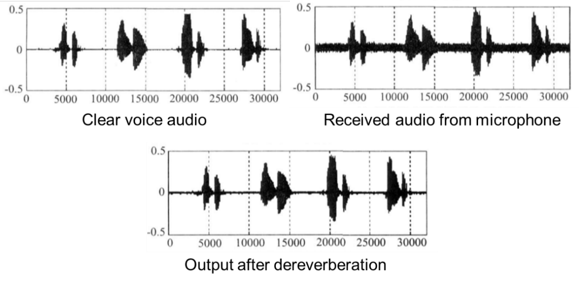
Audio Signal Pre-processing
Speech source localization: This enables the tracking of the target speaker and speech orientation.
Speech enhancement: It involves extracting the purest possible original speech from noisy speech signals.
Dereverberation: Reverberation refers to the sound waves during indoor propagation, such as walls, floors, and other obstacles to form a reflected sound, as well as direct sound to form a superposition.

Slide 11
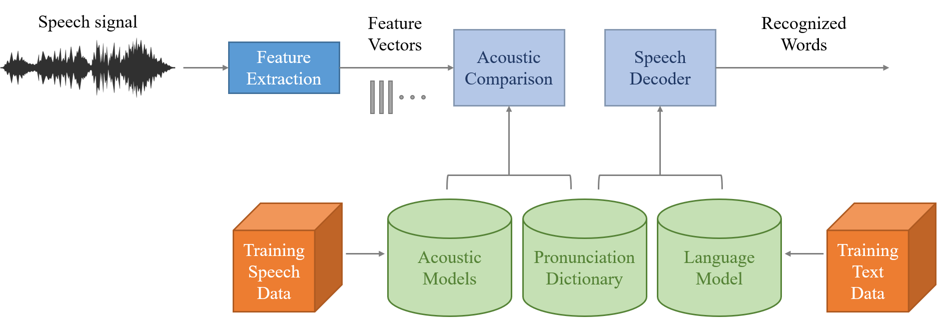
Human–computer Interaction (1)
Automatic Speech Recognition: It is a technology that allows human beings to use their voices to speak with a computer interface. The purpose of speech recognition is to translate speech signals into text. However, in the open real-world environment of smart speakers, speech recognition is still a challenge that needs to be optimized together with front-end signal processing.

Slide 12
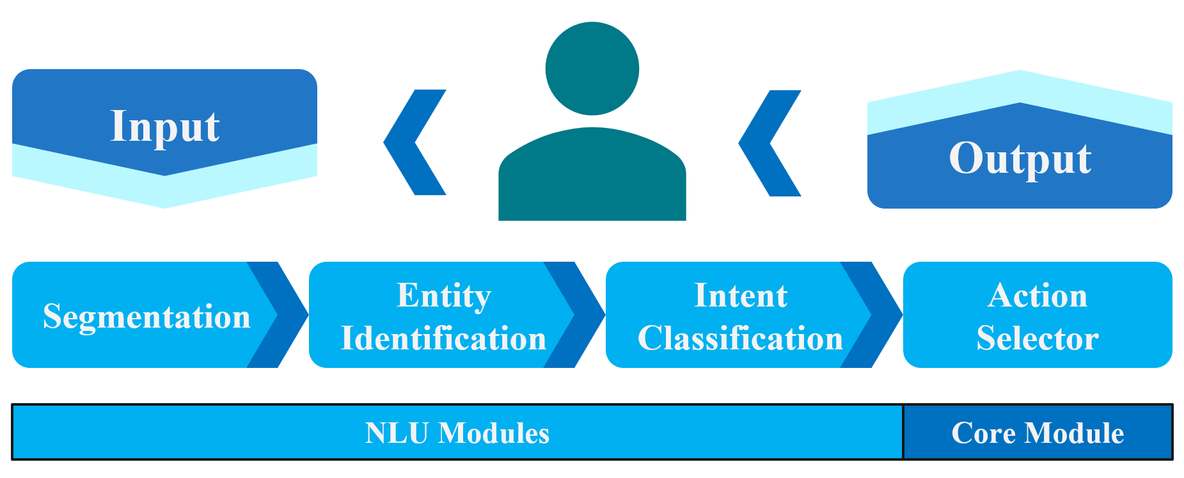
Human–computer Interaction (2)
Natural Language Understanding: Many voice interactions are extremely short phrases, and the speaker not only needs to be able to recognize what the user is saying but also understand the user’s intention. It then converts human language into an artificial language.

Slide 13
Human–computer Interaction (3)
Natural language generation: The main purpose of which is to reduce the communication gap between humans and machines, and convert data from non-linguistic formats into human-understandable language formats.

Slide 14
Human–computer Interaction (4)
In smart speakers, a text-to-speech (TTS) system is the most common speech synthesizer technique. TTS is also called a speech synthesis, which is a useful technology that converts any text into a speech signal by a computer.

Slide 15
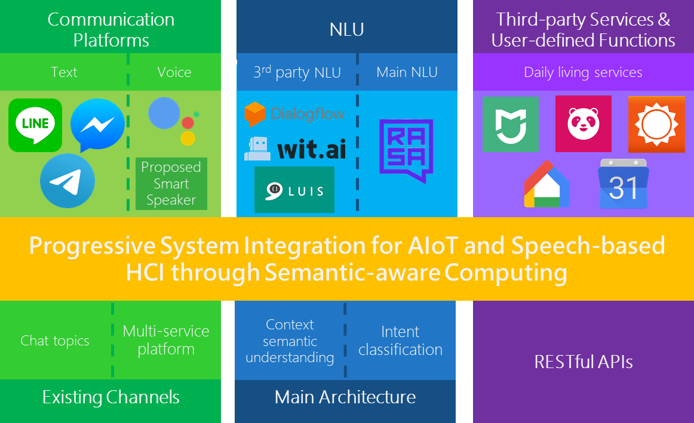
Methodology – Framework Guide
Communication platforms are the front-end interfaces of our backend platform.
NLU agent is based on the open-source Rasa. We integrated hybrid cloud services by RESTful APIs into the semantic-aware assistant, which can easily extend hardware devices and software services.
RESTful-based API is applied to connect many IoT local devices and various third-party services.

Slide 16
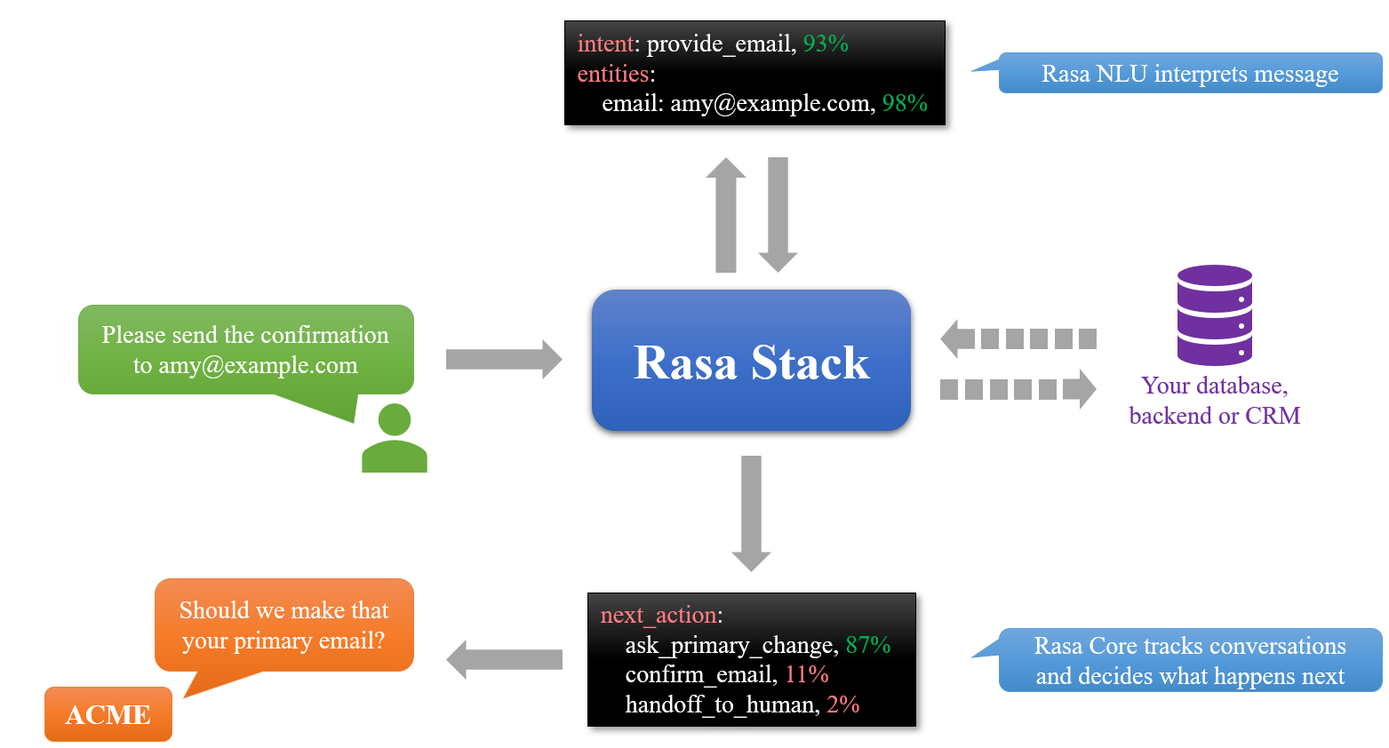
Methodology – Rasa Modules
RASA is mainly divided into two modules:
NLU, which is used for a semantic-aware comprehension of user statements
CORE, which is used for user conversation management

Slide 17
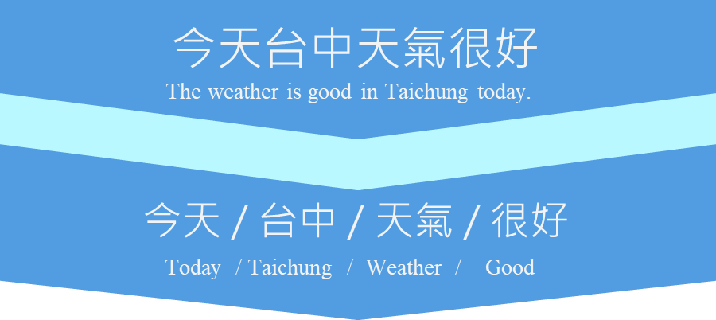
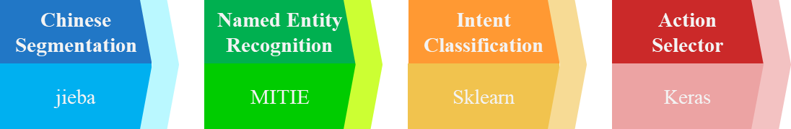
Methodology – Rasa Workflow

Slide 18
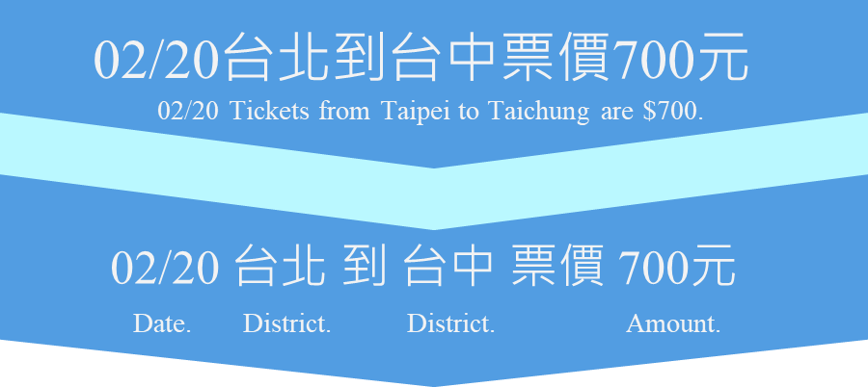
Methodology – Rasa Workflow

Slide 19
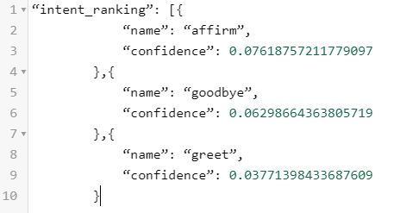
Methodology – Rasa Workflow

Slide 20
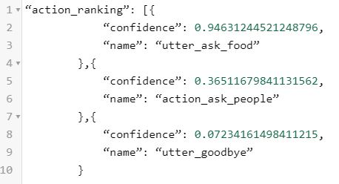
Methodology – Rasa Workflow

Slide 21
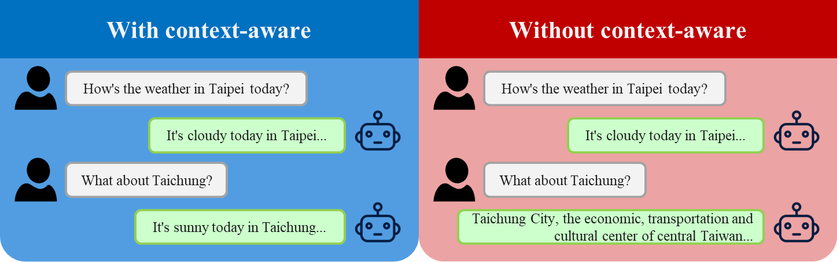
Methodology – Semantic-aware Computing
Comparison of with/without context-aware feature

Slide 22
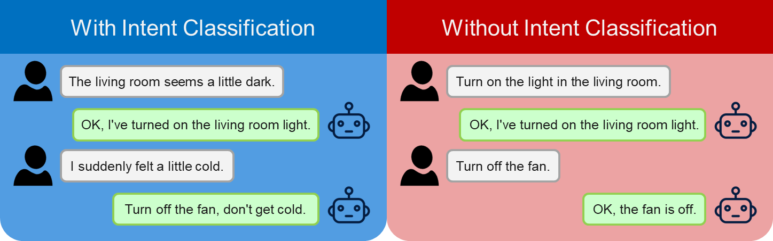
Methodology – Semantic-aware Computing
Comparison of with/without intent classification

Slide 23
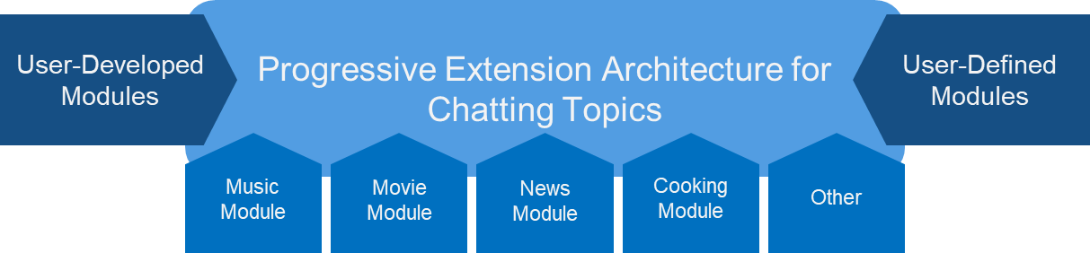
Methodology – Progressive System
Topic Extension

Slide 24
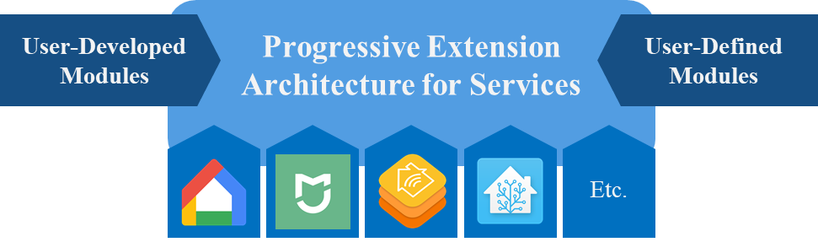
Methodology – Progressive System
Topic Extension

Slide 25
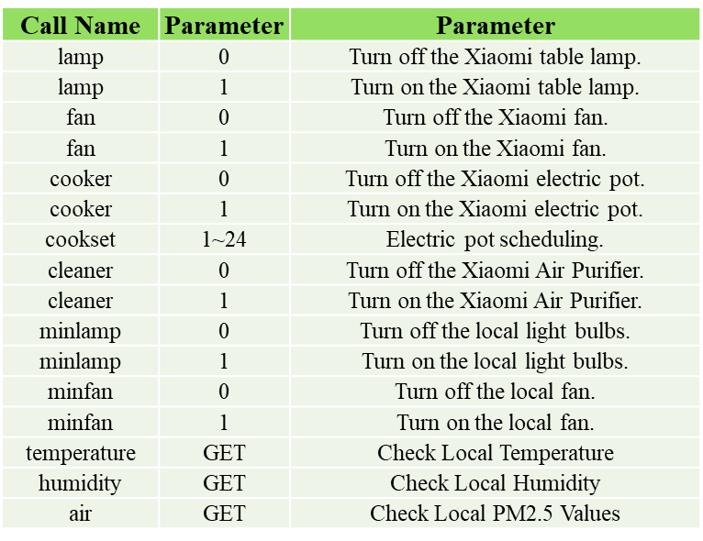
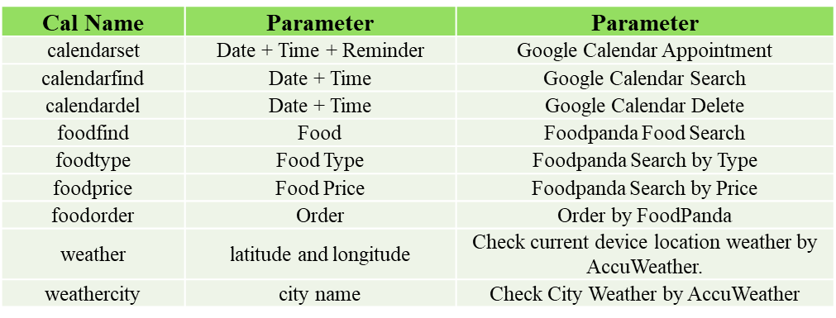
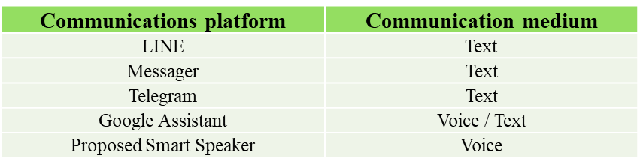
Methodology – RESTful APIs
API tables for IoT devices
API tables for third-party services
API tables for communication platforms

Slide 26
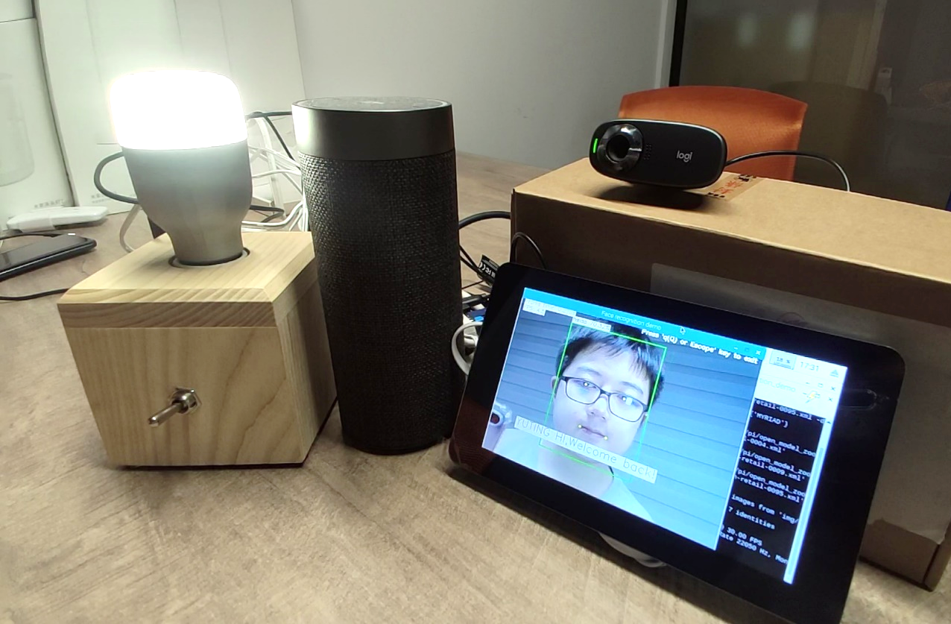
Applications – Case 1. IoT Hub
Main functions:
multi-platform smart speakers
natural language understanding
smart home IoT
access control face recognition
mobile personal assistant
multi-service platform integration
modularized architecture

Slide 27
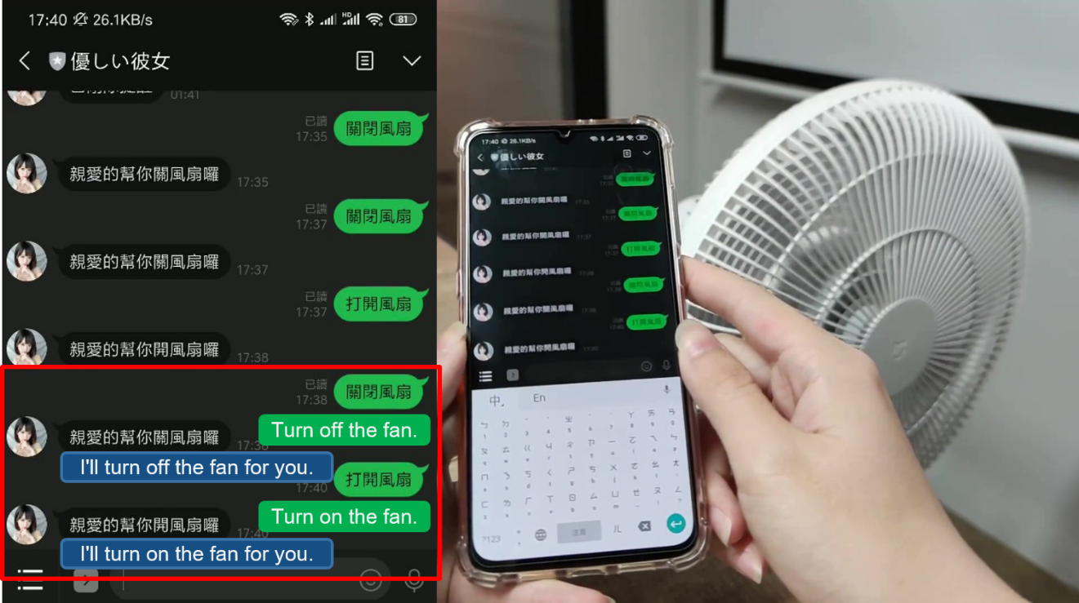
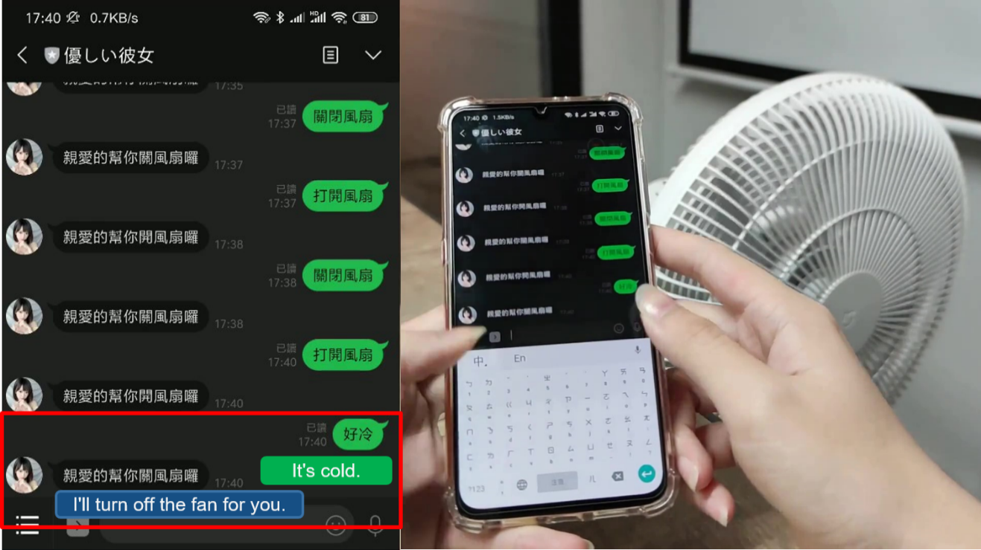
Applications – Case 1. IoT Hub
Standard Commands
Smart Commands

Slide 28
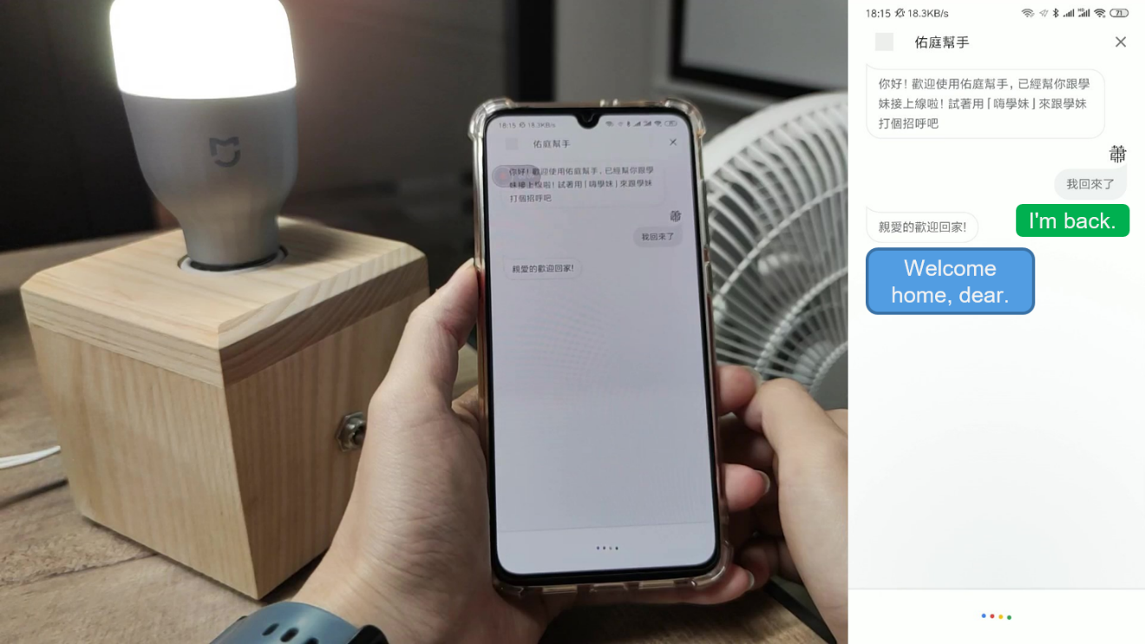
Applications – Case 1. IoT Hub
Google Assistant
Line chatbot

Slide 29
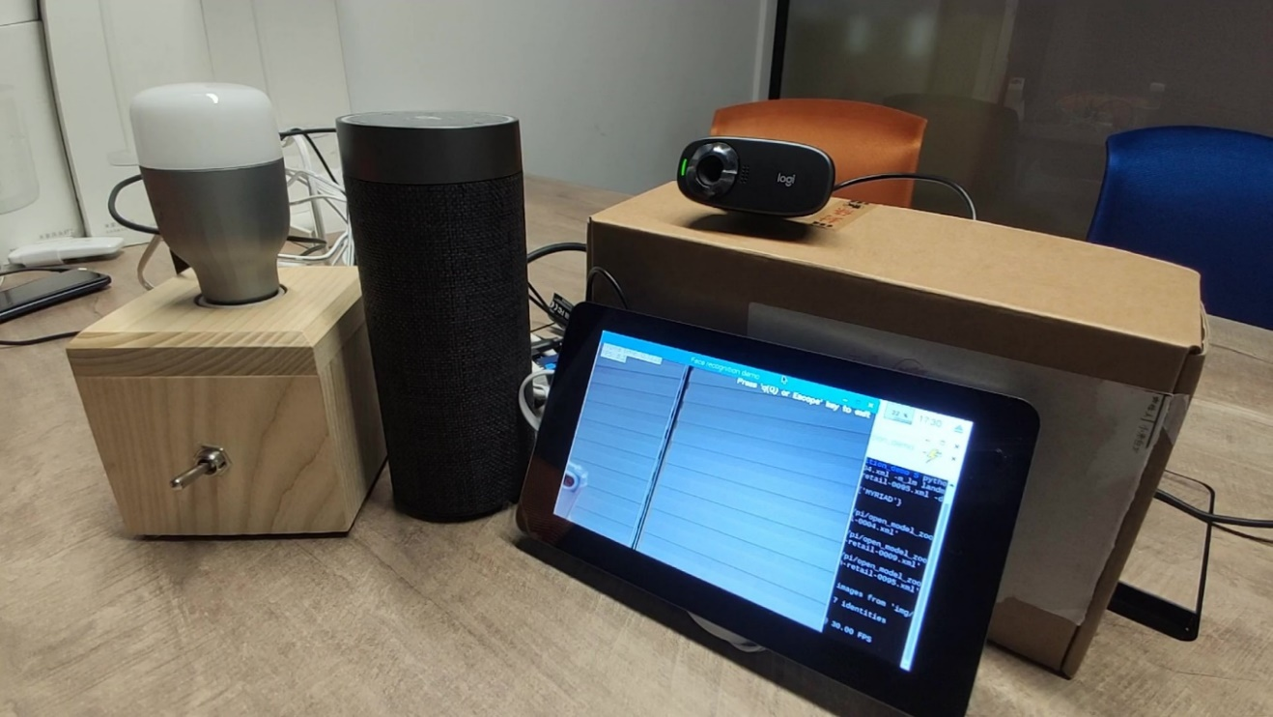
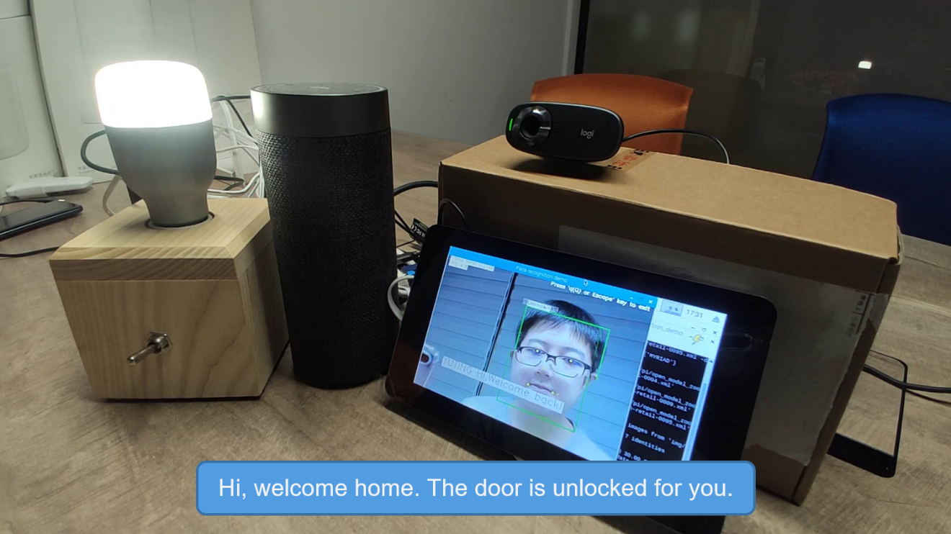
Applications – Case 1. IoT Hub
Face not detected, light off.
Face detected and ID matched, light on.

Slide 30
Applications – Case 1. IoT Hub
Face not detected, light off.
Face detected and ID matched, light on.

Slide 31
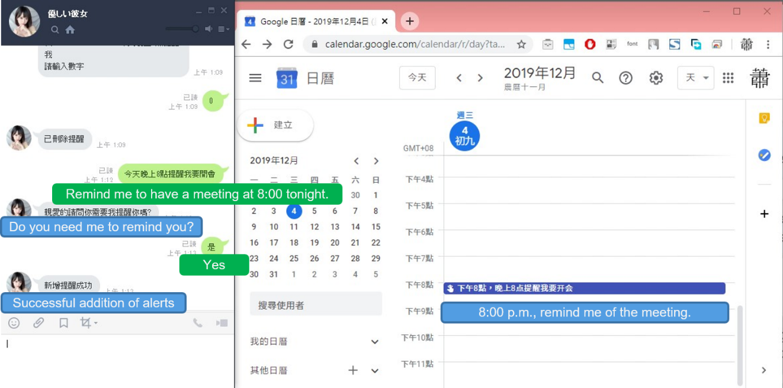
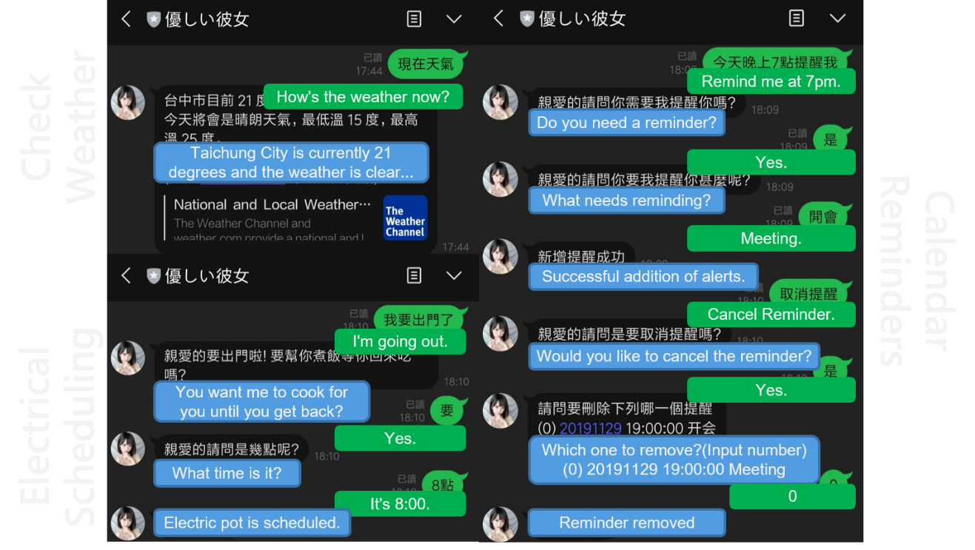
Applications – Case 1. IoT Hub
Multi-service Integration

Slide 32
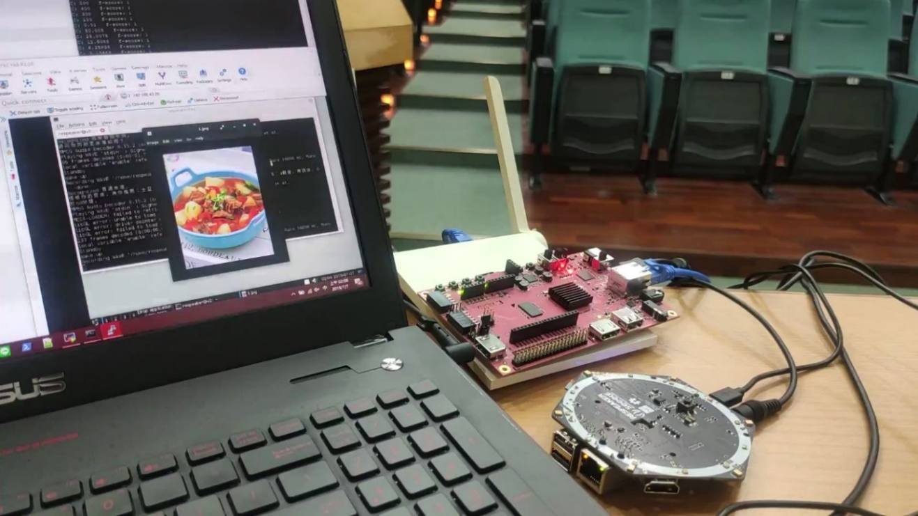
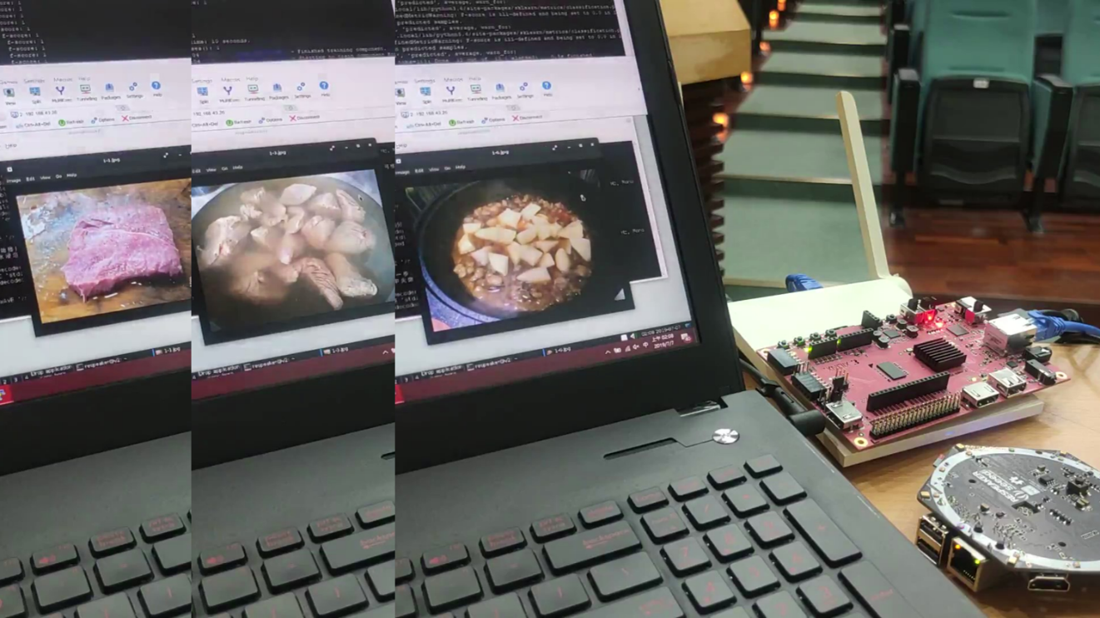
Applications – Case 2. Cookbook GuideBot
Cookbook GuideBot is a smart assistant positioned for cooking. When it is inconvenient to use both hands to operate an electronic device, voice can easily be used to search and recommend recipes based on the user’s existing ingredients and the type of food the user wants to eat. The recommended recipes are taught using a step-by-step voice format.

Slide 33
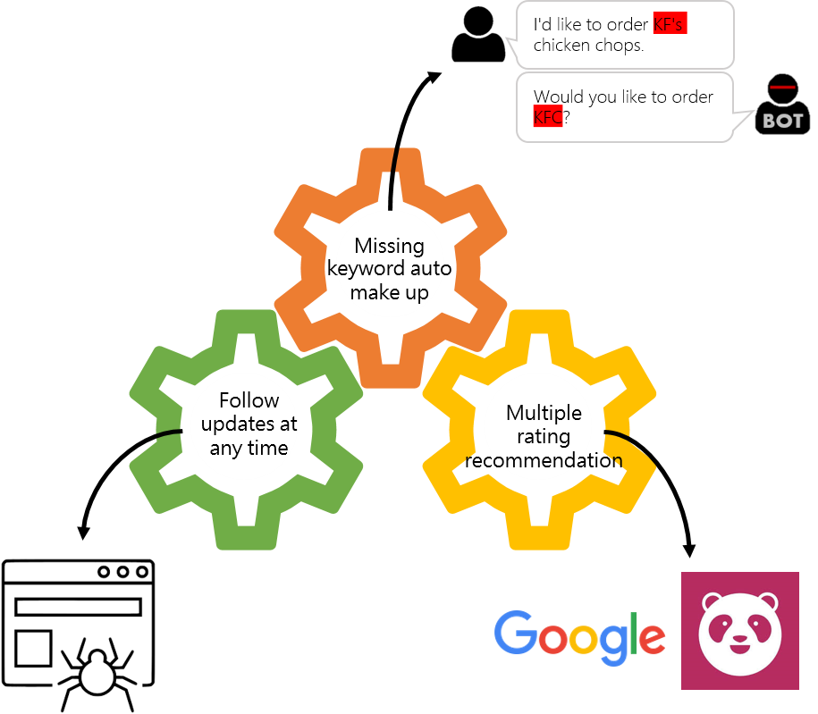
Applications – Case 3. Panda Order
Panda Order combines the Foodpanda platform with its recommendation system. By searching for nearby delivery services, the system will recommend meals based on the criteria provided by users and multiple ratings. If users prefer, they can order a delivery directly through the system.

Slide 34
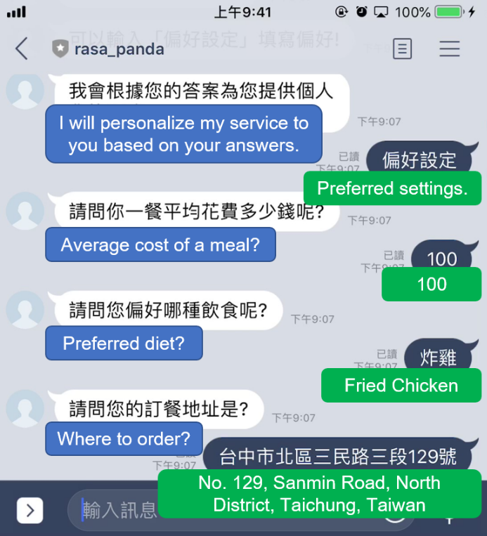
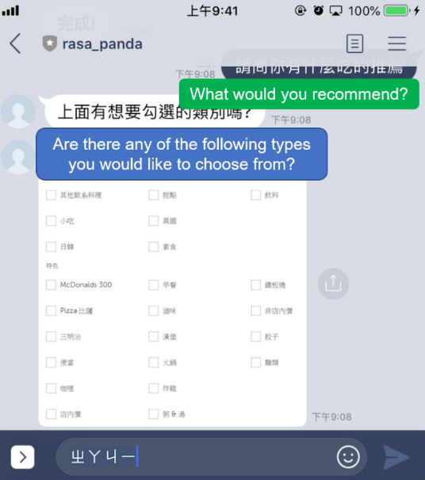
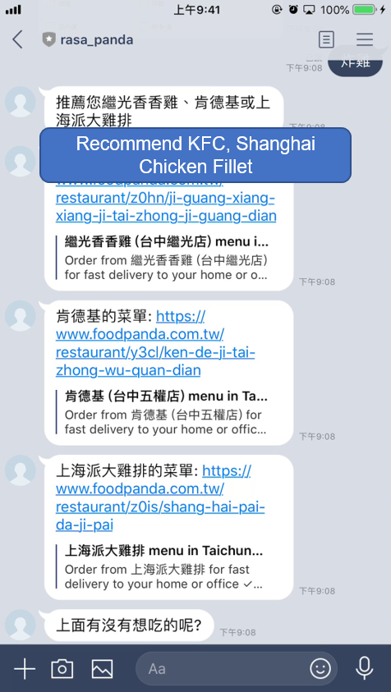
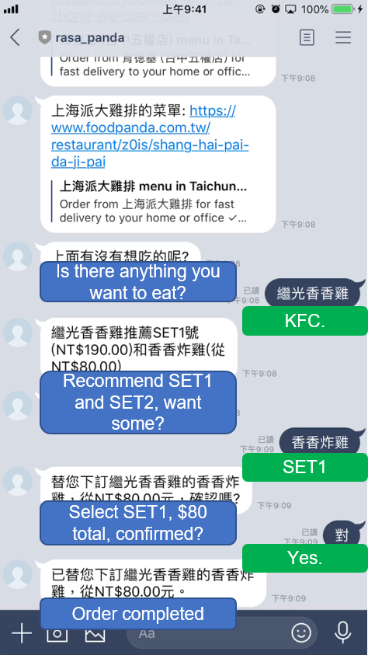
Applications – Case 3. Panda Order
Pre-settings
Type Selection
Recommendation
Order

Slide 35
Conclusion
This study aimed to develop a novel integration architecture for AIoT environments and hybrid cloud services, as well as a speech-based HCI as the user interface of the proposed integration architecture. A progressive growth framework and semantic-aware computing were proposed.
The proposed architecture can address the exclusivity of the Internet of Things (IoT) platform.
For progressive growth, the chat topics can be modularized allowing the NLU agent to be extended and chat with more topics. In addition, different IoT platforms and third-party services can be modularized so that users can load functional modules on demand.
For NLU, semantic-aware computing is used to analyze the user’s intention and to select appropriate feedback and solve the problem of a context-sensitive topic correlation.

Slide 36
Thank you

